Slide 1
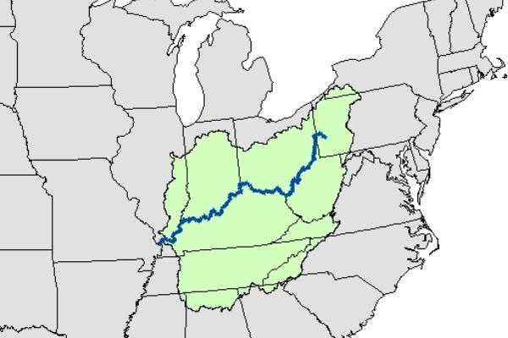
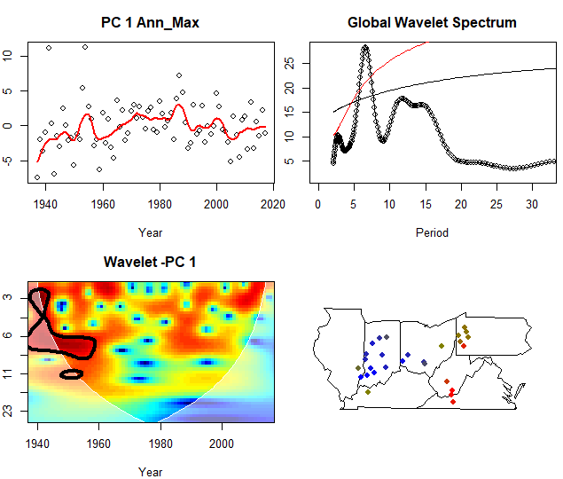
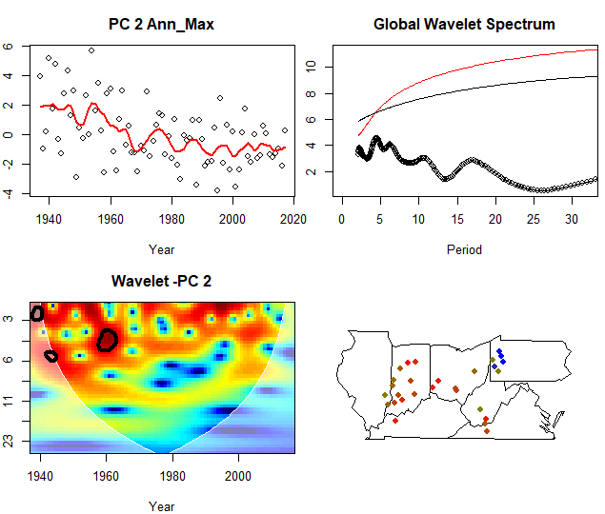
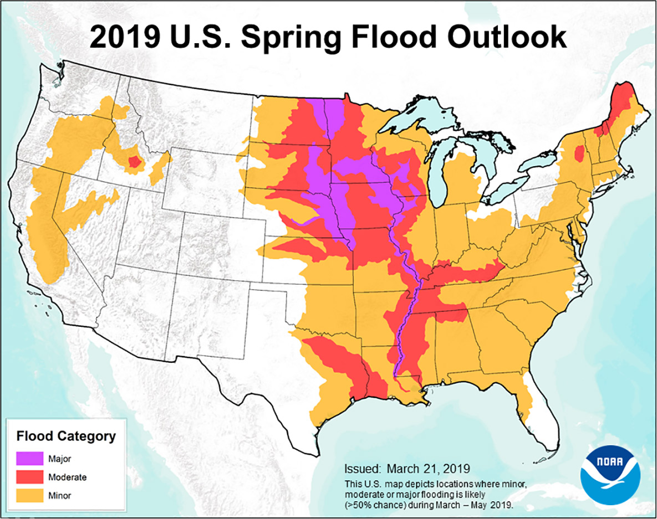
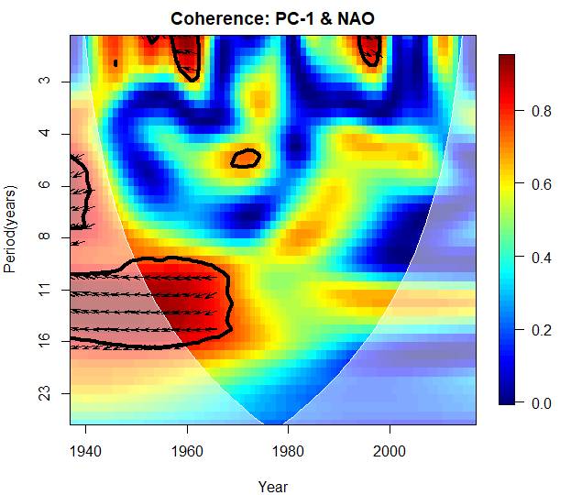
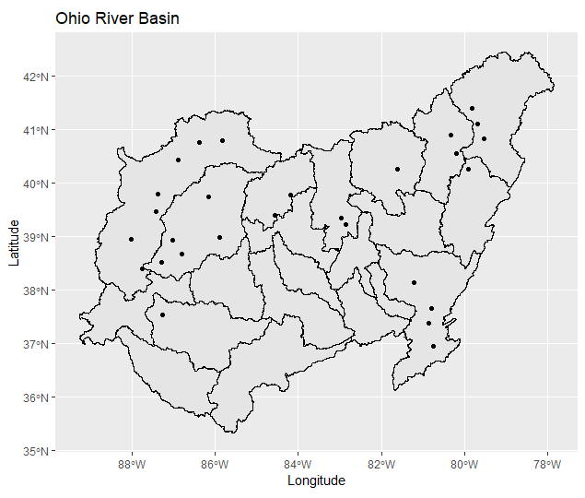
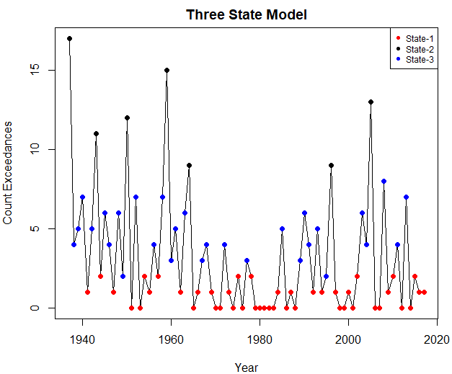
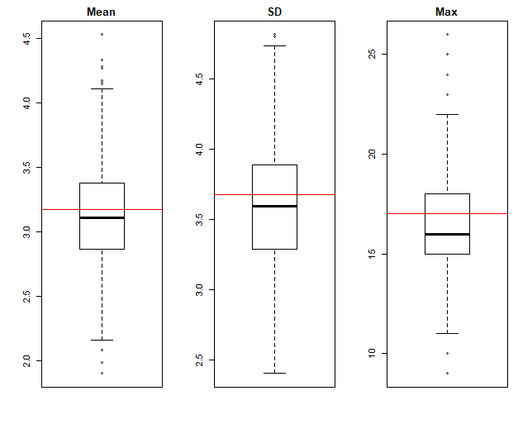
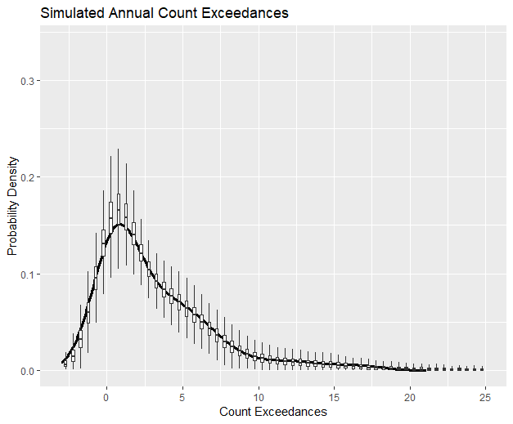
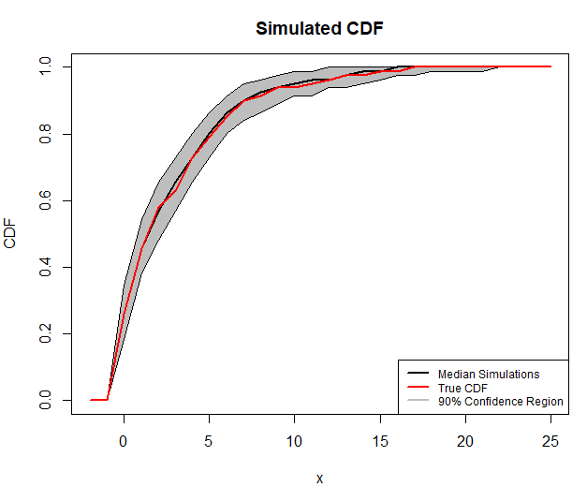
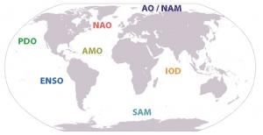
Preserving long-term variability in simulation of multisite streamflow extremes.
Yash Amonkar, James Doss-Gollin, Upmanu Lall
Department of Earth and Environmental Engineering, Columbia Water Center, Columbia University.
Introduction
Floods led to more than half a million deaths worldwide from 1980-2009¹.
Clustered flood occurrences across large regions are particularly catastrophic. This has been observed in the Mid-western USA since the 1930s.
Moseley (1939): “…the centers of greatest storminess over the United States and Canada shift in both latitude and longitude. After moving east for a number of years the location of these centers returns abruptly to a position much farther west. It may be that after ninety years the storm centers return to very nearly the same place which they had at the beginning.”
Brooks(1937)“The conditions causing the excessive rainfall of up from 13 inches in southwestern Indiana to 12.7 in north- central Ohio in March, 1913, were almost identical with those of January, 1937”
Research Question:- What can we infer as to space-time clustering of floods from historical streamflow data from the Ohio River Basin?
1 - Doocy, S., Daniels, A., Murray, S., & Kirsch, T. D. (2013). The human impact of floods: a historical review of events 1980-2009 and systematic literature review. PLoS currents, 5
Ohio River Basin
Results
The Ohio River Basin and upper Mississippi has a long history of large-scale regional flooding in 1882,1913,1937,1997 and most recently in 2011.
Unlike most other regions, the flooding in this basin is dominated by the precipitation and/or snow melt. Though like most floods there are numerous reasons leading up to it.
Figure 4: Ohio River Basin. Credit - Orsanco
Springtime extreme streamflow in the Ohio River Basin is driven by a unique, recurrent, persistent, and strong atmospheric anticyclonic circulation anomaly pattern.
There are clear associations between synoptic circulation types and historical extreme (“10 year”) flood events on the Ohio River Basin. These two circulation types were both found to be preferentially associated with La Niña, providing one causal mechanism for the recent flooding during April of 2011
1. Nakamura, J., Lall, U., Kushnir, Y., Robertson, A. W., & Seager, R. (2013). Dynamical structure of extreme floods in the US Midwest and the United Kingdom. Journal of Hydrometeorology, 14(2), 485-504.
2. Farnham, D. J., Doss‐Gollin, J., & Lall, U. (2018). Regional Extreme Precipitation Events: Robust Inference From Credibly Simulated GCM Variables. Water Resources Research, 54(6), 3809-3824.
3. Robertson, Andrew W., et al. "Weather and climatic drivers of extreme flooding events over the midwest of the United States." Extreme Events: Observations, Modeling, and Economics (2015): 113-124.
This forecast has turned out true with record breaking floods across the Mid-west, surpassing the last great floods of 1993^{1,2}. This has been the wettest 12 months in the history of United States since 1895³, and the longest flood duration since 1927 on the Mississippi
Across the media, climate change is invoked^{2,4}. However, the region has a 200 year history of great floods that are synchronous across the region
Figure 5 :- Wavelet Analysis on the 1st Principal Component of the spatial cluster. TOP-LEFT – 1st PC of cluster with a loess line. TOP-RIGHT – Global Wavelet Spectrum of the PC. BOTTOM-LEFT – Power Spectrum of the Wavelet. BOTTOM-RIGHT – Spatial Distribution of the Loadings(Size indicates their drainage area.
Component | Correlation
ENSO | 0.21
NAO | -0.31
PDO | 0.16
ENSO-NAO | 0.01
ENSO-PDO | 0.27
NAO-PDO | 0.01
Figure 1:- NOAA 2019 Spring Flood Outlook¹
Methodology
Streamflow
Daily Data from _____ stations for the period 1937-2017 were used.
Streamflow gauges were selected which had a drainage area greater than 1450 sq. Miles.
Wavelet Clustering: Are there common recurrent patterns of flooding with a characteristic frequency?
Compute Wavelet spectra for each streamflow site.
Hierarchical Clustering of Wavelet Spectra to identify common time-frequency structure in flooding. Using Silhouette Analysis the number of clusters in the field were identified.
For each cluster, principal component analysis was carried out on the field and the 1st PC was selected.
Wavelet Analysis was carried out on the 1st PC to illustrate the identified time-frequency pattern
Compute Wavelet for the 1st PC for each cluster and the relevant Climate Indices.
For a robust inference, nested analysis was carried out using more station data but a shorter study period of 39 years(1979-2017).
Data Sources
Hirsch, R.M., and De Cicco, L.A., 2015, User guide to Exploration and Graphics for RivEr Trends (EGRET) and dataRetrieval: R packages for hydrologic data (version 2.0, February 2015): U.S. Geological Survey Techniques and Methods book 4, chap. A10, 93 p., http://dx.doi.org/10.3133/tm4A10
Gopi Goteti and Joseph Stachelek (2016). dams: Dams in the United States from the National Inventory of Dams (NID). R package version 0.2. https://CRAN.R-project.org/package=dams
KNMI Climate Explorer - https://climexp.knmi.nl/
Streamflow Gauges - USGS/Data Retrieval Package in R¹.
Dams – National Inventory of Dams/Dams package in R².
Climate Indices³
ENSO – Nino 3.4 – HadISST
PDO – JISAO
AMO – HadSST
NAO – Jones et al.
Figure 2:- Stream Gauges.
 | 1 | 2 | 3
1
2
3
Conclusions
The Ohio River Basin shows significant clustering in the regional stream-flow with further ramifications in the understanding of the local climatology and for the design of critical infrastructure in the region.
The network of aging dams in the region, may be vulnerable to cascading failure under the spatially and temporally correlated extreme events. A repeat of the 1937 event could be catastrophic.
Nuclear power plants in the region are located near rivers, and do not have adequate protection under a scenario of upstream dam failures¹.
Large scale climate drivers induce space and time clustering in the occurrence of flooding in this region, even without an anthropogenic climate change, with significant regional impact on losses and supply chains.
Perkins, R. H., Bensi, M. T., Philip, J., & Sancakatar, S. (2011). Screening analysis report for the proposed generic issue on flooding of nuclear power plant sites following upstream dam failures. NRC, Washington, DC. US Nuclear Regulatory Commission, Office of Nuclear Regulatory Research, Division of Risk Analysis
Figure 3:- Global Climate Indices. Courtesy - UCAR

